Slide 1

Customer Retention Case Study
by
Alivia Dasgupta

Slide 2

What is customer retention?
Customer retention refers to the ability of a company or product to retain its customers over some specified period.^{[1]} High customer retention means customers of the product or business tend to return to, continue to buy or in some other way not defect to another product or business, or to non-use entirely.
Customer retention starts with the first contact an organization has with a customer and continues throughout the entire lifetime of a relationship and successful retention efforts take this entire lifecycle into account.
Customer retention has a direct impact on profitability.

Slide 3
What are the benefits of customer retention?
Cheaper than Acquisition: Foremost advantage of customer retention for every organization is that saves the cost involved in acquiring new customers. Customer retention is five times more economical than the acquisition process and thereby a most cost-effective method of maintaining a customer base. Several kinds of research have been conducted in the past which has favored retention over the acquisition process.
Loyal customers yield higher profits: Companies are able to yield higher profits by maintaining loyal customers. These customers make more frequent purchases and spend large in every transaction with their brand. Loyal customers do tend to shift frequently even if their brand raise price, they continue for long. However, every company need to be cautious while raising their prices as end goal is lifetime revenue not just today’s revenue.
More word of mouth referrals: Customer retention enable companies in getting large amount of referrals easily. Loyal customers serve as an important source of new business as they bring in large number of customers by referring them brand products. Peoples get attracted toward brand easily through referral of their friends and relatives despite various online and mobile marketing.
Easy up-selling and cross-selling: Business find it easier in up-selling and cross-selling its products to group of loyal customers. Once people are satisfied with the services of particular brand; they like to explore more of its stuff. Customer don’t go for much analysis and comparison of brand products while making purchase decisions if they are assured of its quality.
Loyal customers are more forgiving: Another major advantage of customer retention is that it enables in getting better co-operation from people. Loyal customers are more forgiving and they support their brand even if they get a poor service experience. Business get better support from its customers in its hard times that ensure its long-term continuity.
Better communication with customers: Customer retention is an effective tool available to business for establishing proper communication network with customer. Customer that engages with business for long term shares their valuable feedback with their brand. They communicate information regarding people’s demand and expectation from business that enables it in formulating effective policies

Slide 4

Retention tactics.
Track and analyze churn metrics.
Implement a customer feedback loop.
Maintain a customer communication calendar.
Send a company newsletter.
Start a customer education program.
Build trust with your customers.
Offer unique services.
Start a customer retention program.

Slide 5
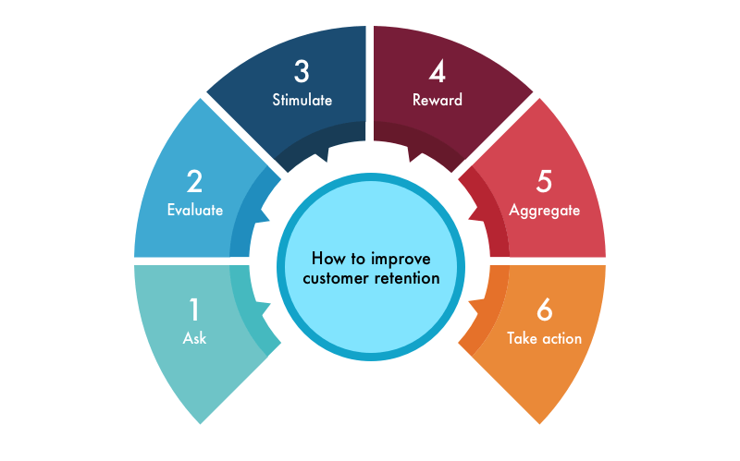
How to improve customer retention?

Slide 6
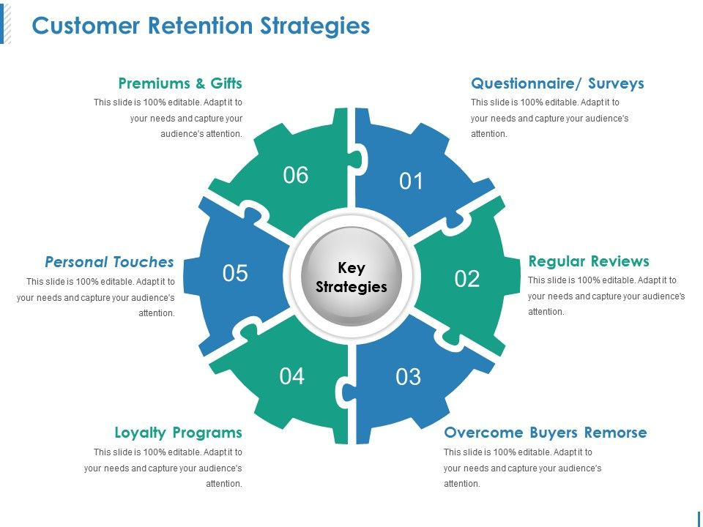
Strategies of customer retention

Slide 7
Let’s analyse customer feedback to gain some useful insights.
What data we have?
We have 269 customers over 71 questions each.
Let’s do Exploratory Data Analysis for some useful insights.

Slide 8
Who is out potential customer?

Slide 9
City distribution in top 12 cities for e-commerce.

Slide 10
Customer preferences
Device to use to access the online shopping

Slide 11
What browser do you run on your device to access the website?

Slide 12
How do you reach the online retail store?

Slide 13
Shopping pattern
Since how long you are shopping online?
How many times you have made an online purchase in the past 1 year?

Slide 14
Online retailer preferred

Slide 15
Easy to use Platform
Easy to use website or application
Visual appealing web-page layout
Conclusion:
Amazon platform is first choice where online shopping is easy with speedy order delivery
Flipkart platform is second choice of customers
Myntra secured the 3rd place in customers choice
Snapdeal is on 4th position
Paytm is the 5th choice

Slide 16
Product Availability
Conclusion:
1. Amazon have variety of products with complete ,relevant information
2. Flipkart is on 2nd choice
3. Myntra is on 3rd Choice
4. Snapdeal secured 4th position
5. Paytm is on 5th position in Product availability category

Slide 17
Conclusion: 1.Amazon is technically best platform as per customer choices 2.Flipkart is on the 2nd position in this category 3.Paytm secured 3rd position on platform stability 4.Myntra is on 4th position 5.Snapdeal is on 5th position
Platform Technical performance

Slide 18
Which of the Indian online retailer would you recommend to a friend?
Conclusion:
Clearly, Amazon is leading
In most of the categories to
Customers first recommendation.

Slide 19

Conclusion
Customer Retention is the most effective way to grow a business and it is one of the keys to success. Acquiring new customers are always more expensive and takes more effort than retaining them. Therefore it is crucial for business, to try to keep the retention rate up, with the tips mentioned here or more, in order to have better conversion rates, lower marketing costs, and higher profits.

Slide 20
Thank YOu

